Slide 1
Project Presentation
CMSC 122 Computer Science with Applications II
Winter 2017
Team: Something Creative

Slide 2
Goal of the Project
Use a predictive algorithm to forecast future real estate price listings based on neighborhood/district characteristics in Chicago
Practice using Python to make a concretely marketable and useful website

Slide 3
Source
Neighborhood quality data:
City of Chicago data portal
Crime Rate, School Quality, Local Amenities, Local Unemployment,
Per Capita Income, Hardship, Crowding
Housing price data:
Trulia(Residential Real Estate Site)’s Chicago Home Prices Page

Slide 4
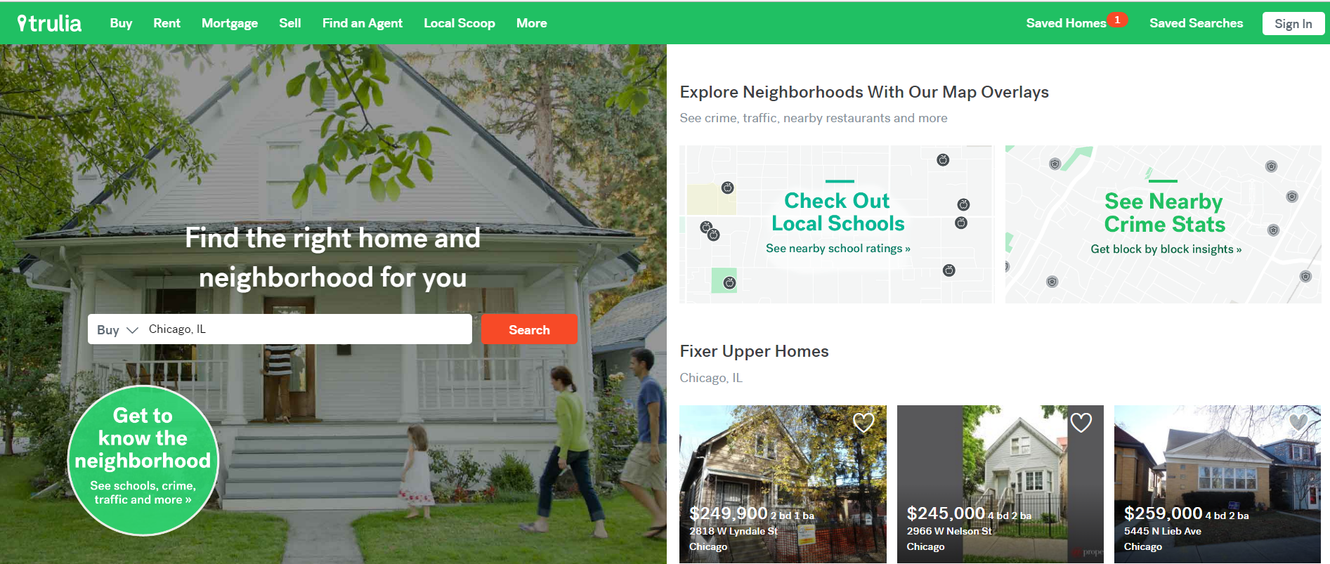

Slide 5
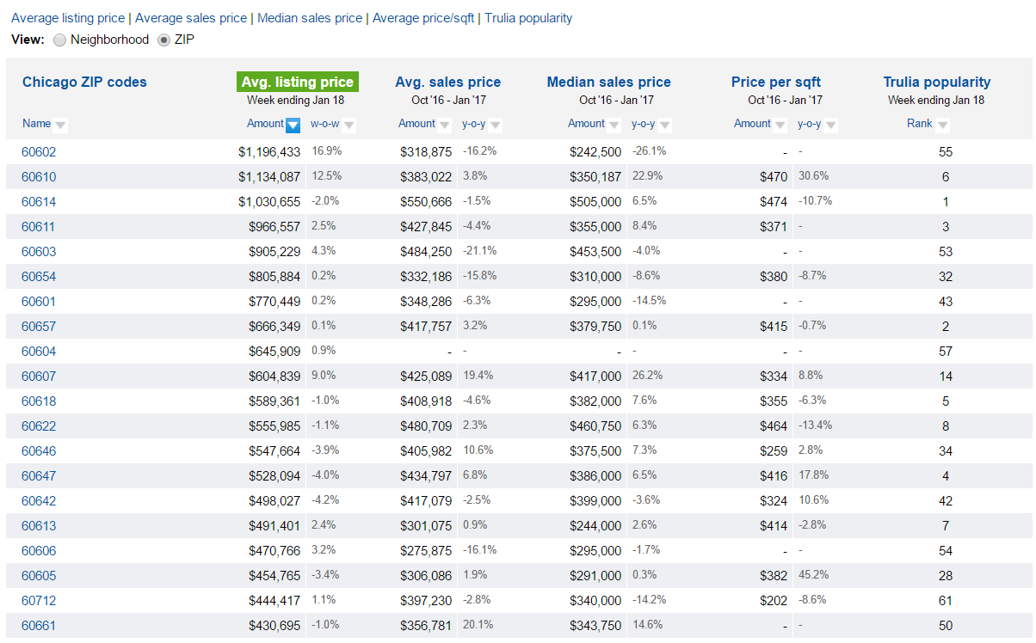

Slide 6
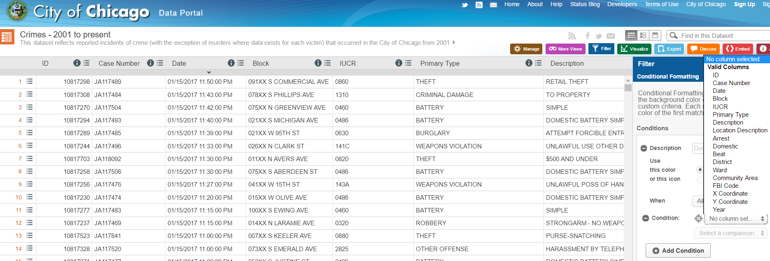

Slide 7
Work Involved
Scrape the data from both websites, and store them into .csv files
Develop statistical models to forecast real estate prices, including checking assumptions are met, and ensuring models are statistically sound
Build a website that allow users to enter their zip code, size of their properties and year. The website would return estimated median price for the house.

Slide 8
Expected Hardship
Modeling
Distribution of Trulia pricing data
Significant variables for regression
Assumptions checks
Data Scraping
Missing Communities (in one dataset but not in another)
Data entry errors (missing names, duplicates, etc.)
Implementation
Learning new libraries (pandas, scipy…)
Creating a website
Embedding python program in a webpage

Slide 9
Timeline
Jan 23 ~ Jan 29 (4th week): Scraping Trulia’s Chicago Home Prices Data into a csv file/ Proposal Presentation
Jan 30 ~ Feb 05 (5th week): Using scraped data and setting up a regression model, check for validity
Feb 06 ~ Feb 12 (6th week): Implementing model and data into Python program/ Progress Check-in
Feb 13 ~ Feb 19 (7th week): Creating a database with scraped data and predicted values
Feb 20 ~ Feb 26 (8th week): Building a webpage (1)/ Progress Check-in
Feb 27 ~ Mar 03 (9th week): Building a webpage (2)
Mar 04 ~ Mar 10 (10th week): Debugging, quality checks
Mar 11 ~ Mar 14: Wrap-up, Program Submission & Presentations

